Slide 1
ME3500 F-Lab 1
Self-Lockable Linkage: Gripping

Slide 2
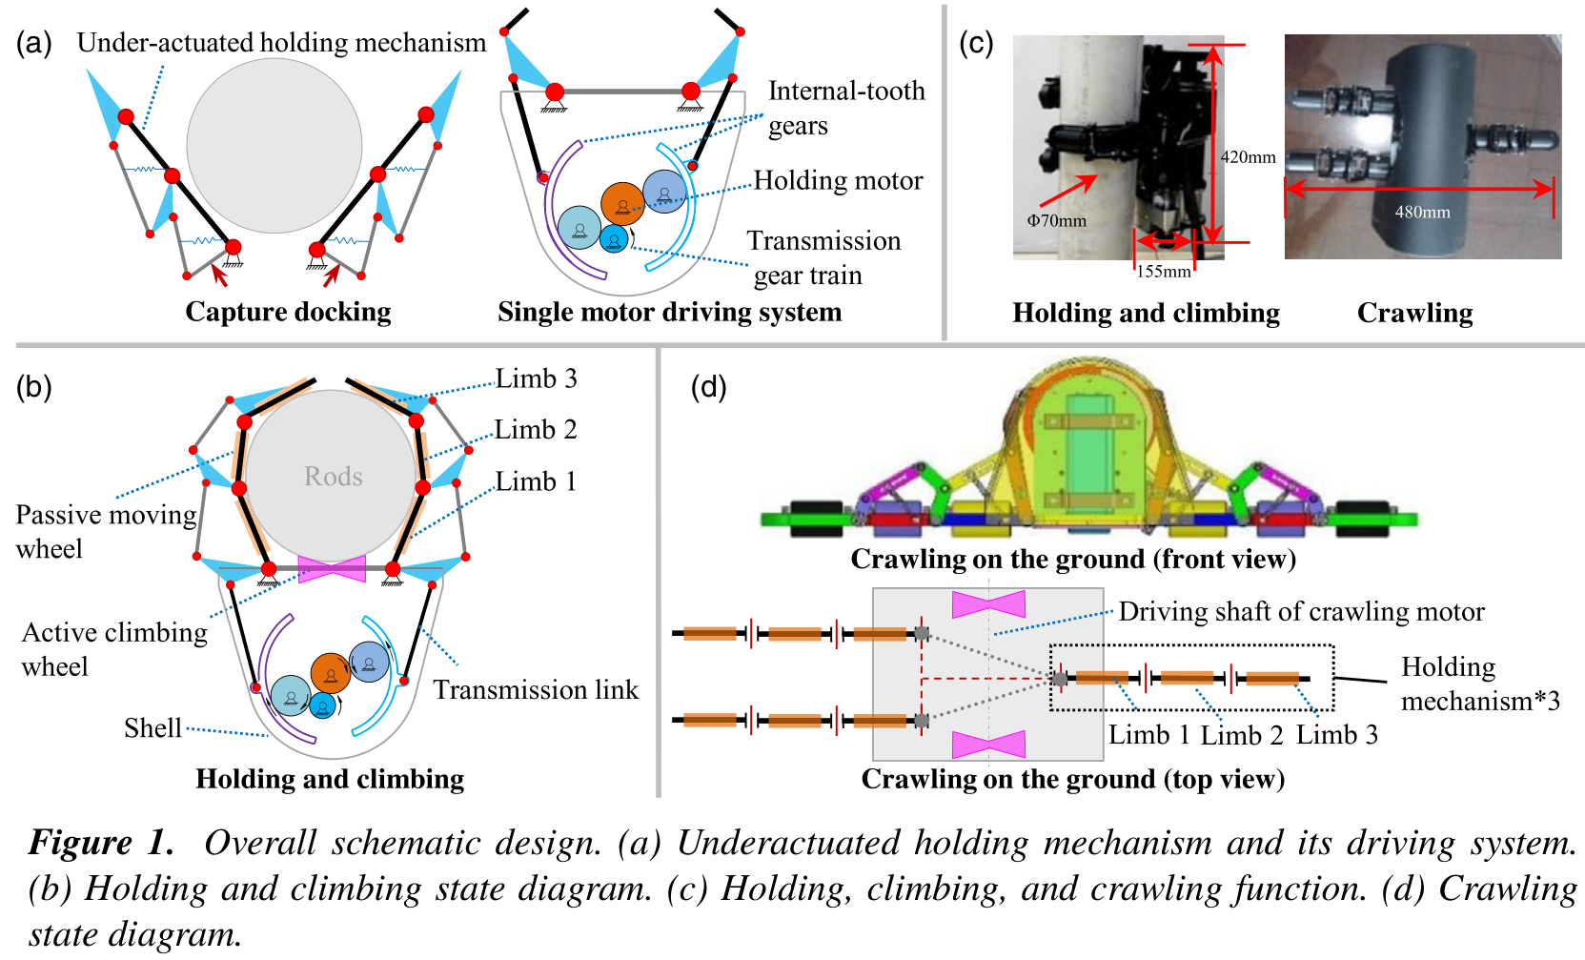
Case Study: self-adaptive climbing robot
Three-Limb Configuration
Each limb has three joints for flexibility.
Staggered arrangement for optimal coverage.
Self-Adaptive Grasping
Mechanism adjusts to different object sizes.
Achieves circumferential holding of cylindrical shapes.
Mechanical Components
Includes linkage mechanisms, passive wheels, and springs.
Liu Y, Yu Y, Wang D, Yang S, Liu J. Mechatronics design of self-adaptive under-actuated climbing robot for pole climbing and ground moving. Robotica. 2022;40(7):2255-2274. doi:10.1017/S0263574721001636
Notes:
The holding mechanism consists of three limbs, each equipped with three joints, allowing for a high degree of flexibility and adaptability. The limbs are arranged in a staggered configuration, ensuring that they can effectively grasp objects of various diameters without interference. This design enables the robot to achieve circumferential holding, which is crucial for climbing stability. The mechanism incorporates various mechanical components, including linkage systems that facilitate movement, passive wheels that assist in grip, and springs that provide additional force during the opening and closing actions of the limbs. This combination of features allows the robot to adaptively grasp objects ranging from 40 mm to 100 mm in diameter.

Slide 3
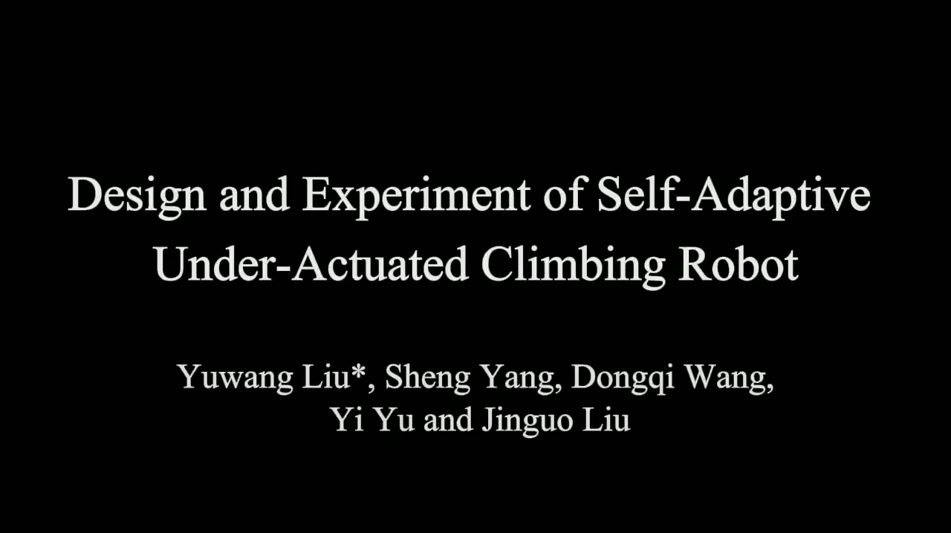
Case Study: self-adaptive climbing robot
Linkage System:
Limb 1–3: Optimized lengths (L1=65mm, L2=55mm, L3=70mm) for force equilibrium.
Four-Bar Linkages: Two sets (upper/lower) per limb to transmit torque proportionally.
Passive Wheels: Mounted on limbs for smooth climbing transitions.
Springs: Provide auxiliary force for grip stability and compliance.

Slide 4
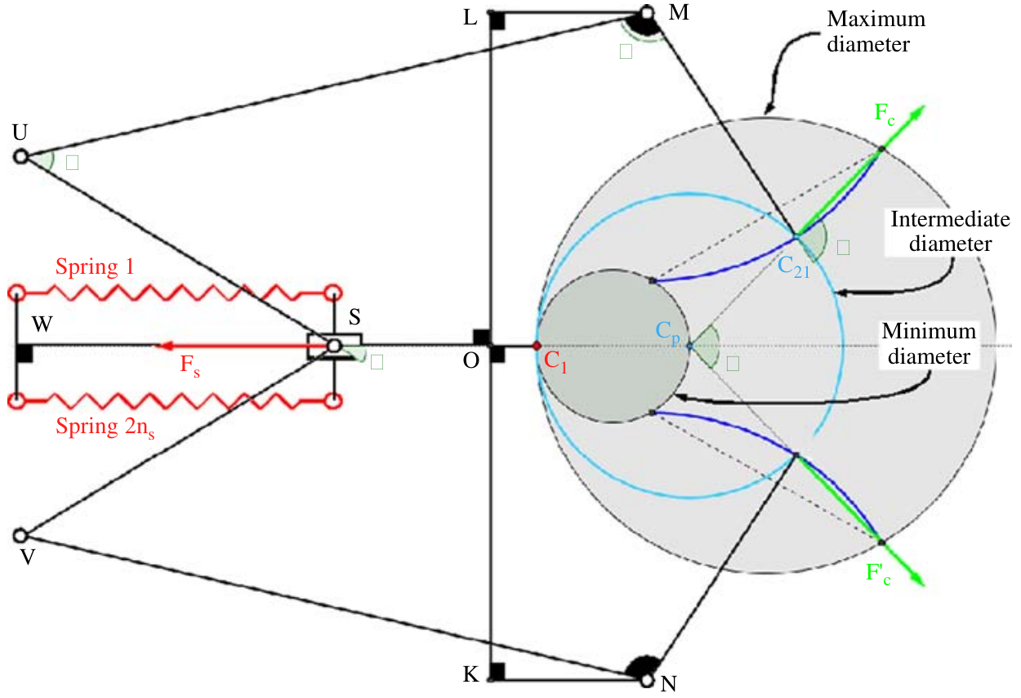
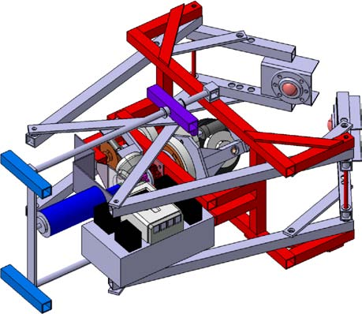
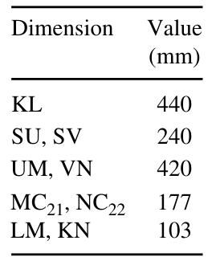
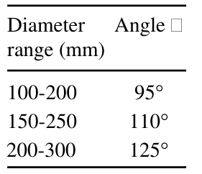
Case Study: self-adaptive climbing robot
Linkage Mechanism Design:
Two arms form support points (C₂₁, C₂₂) adjustable via a four-bar linkage.
Arms move in synchrony to maintain an approximately equilateral support triangle around the pole.
Spring-Based Passive Force Regulation:
Multiple springs (up to 16) connected from frame to sliding rail regulate clamping force.
Folded arm geometry (angle α adjustable via clips) offers three preset diameter ranges for conical poles.
Mechanism is non-linear: stiffest at maximum open, releasing force at narrowest position.
Benefits:
Ensures stability without excessive squeezing; adapts to surface friction and pole irregularities.
Fauroux, J. and Morillon, J. (2010), "Design of a climbing robot for cylindro‐conic poles based on rolling self‐locking", Industrial Robot, Vol. 37 No. 3, pp. 287-292.

Slide 5
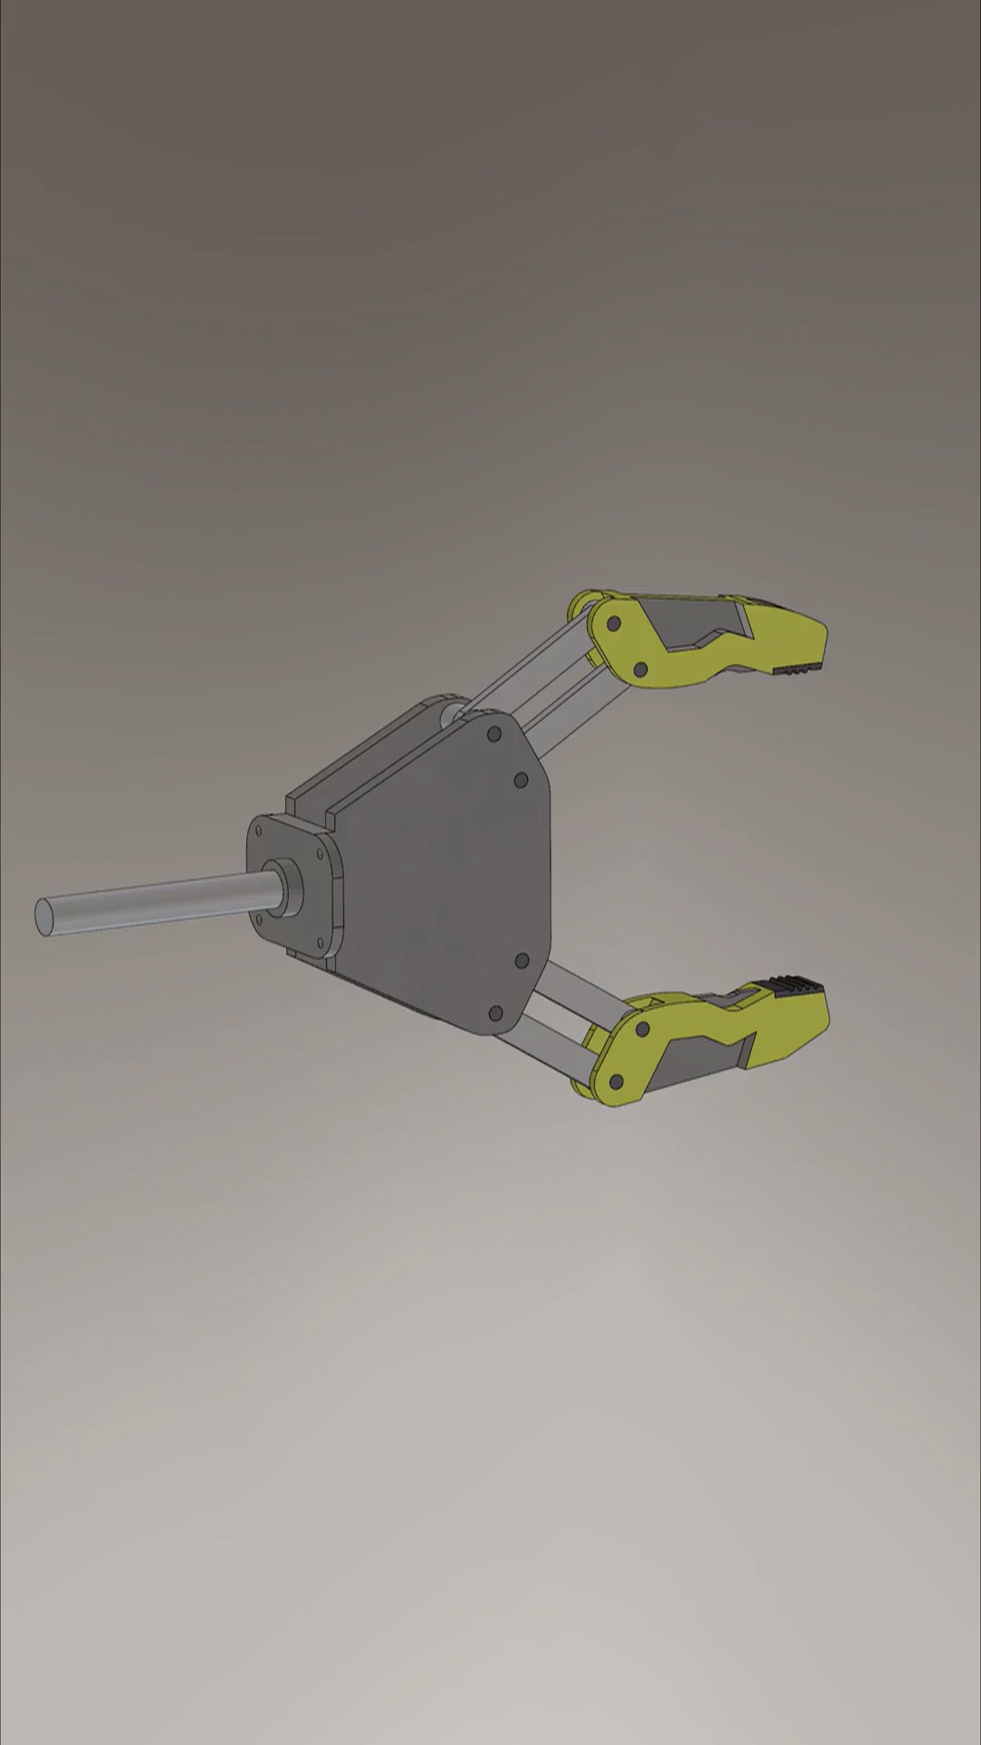
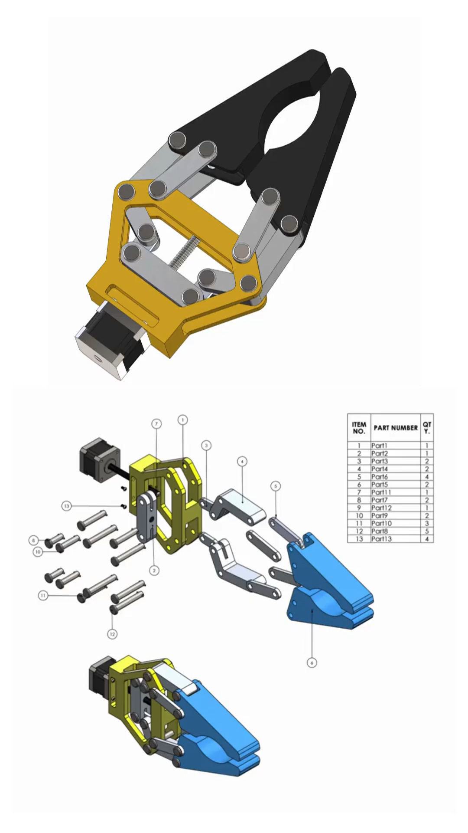
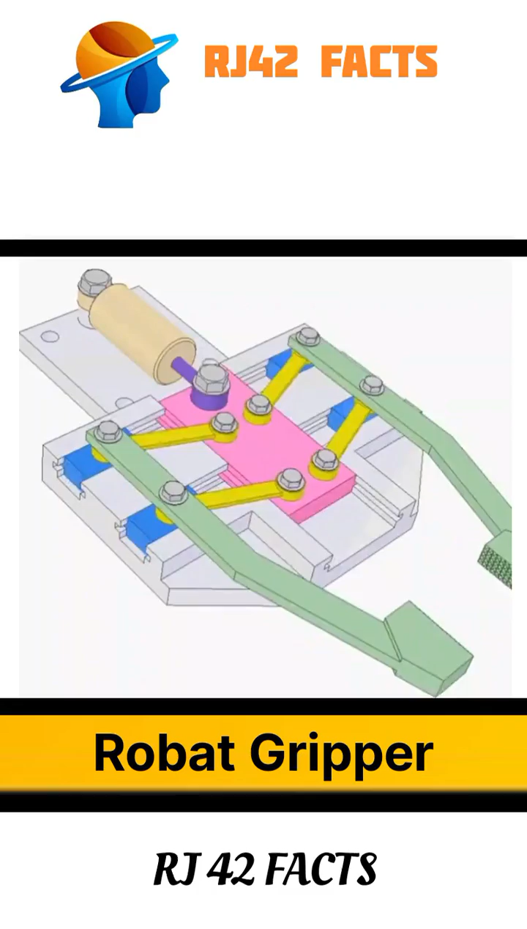
Sample Videos for Robotic Gripper
Notes:
Here we give some simplified

Slide 6

Sample Videos for Robotic Gripper Design

Slide 7
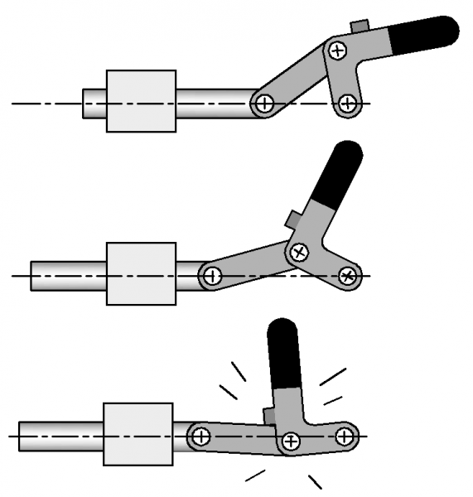
Design of Self-Locking Mechanism
Toggle Position Case study 1: Over Center Linkages
Definition
Mechanical linkage using pivoting joints to create a self-locking mechanism.
Actuated by levers, cams, or springs.
Working Principle
Uses mechanical advantage near the “over-center” point.
Force increases as linkage approaches over-center, then decreases after passing it, ensuring self-locking.
Design Considerations:
Force & travel distance requirements.
Link/joint size & shape.
Critical: Over-center angle selection for proper locking force.
Notes:
https://engineeringtechnology.org/equipment-and-machine-elements/linkages/over-center-linkages/

Slide 8
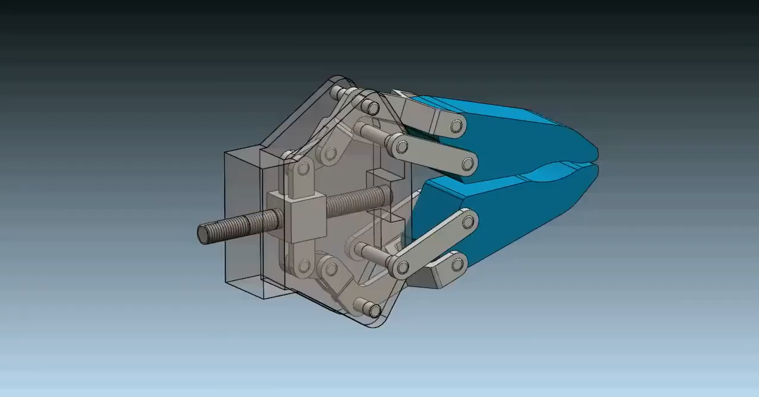
Design of Self-Locking Mechanism
Combination for locking?
Notes:
Possibility to modify the linkage lengths and achieve locking mechanism.

Slide 9
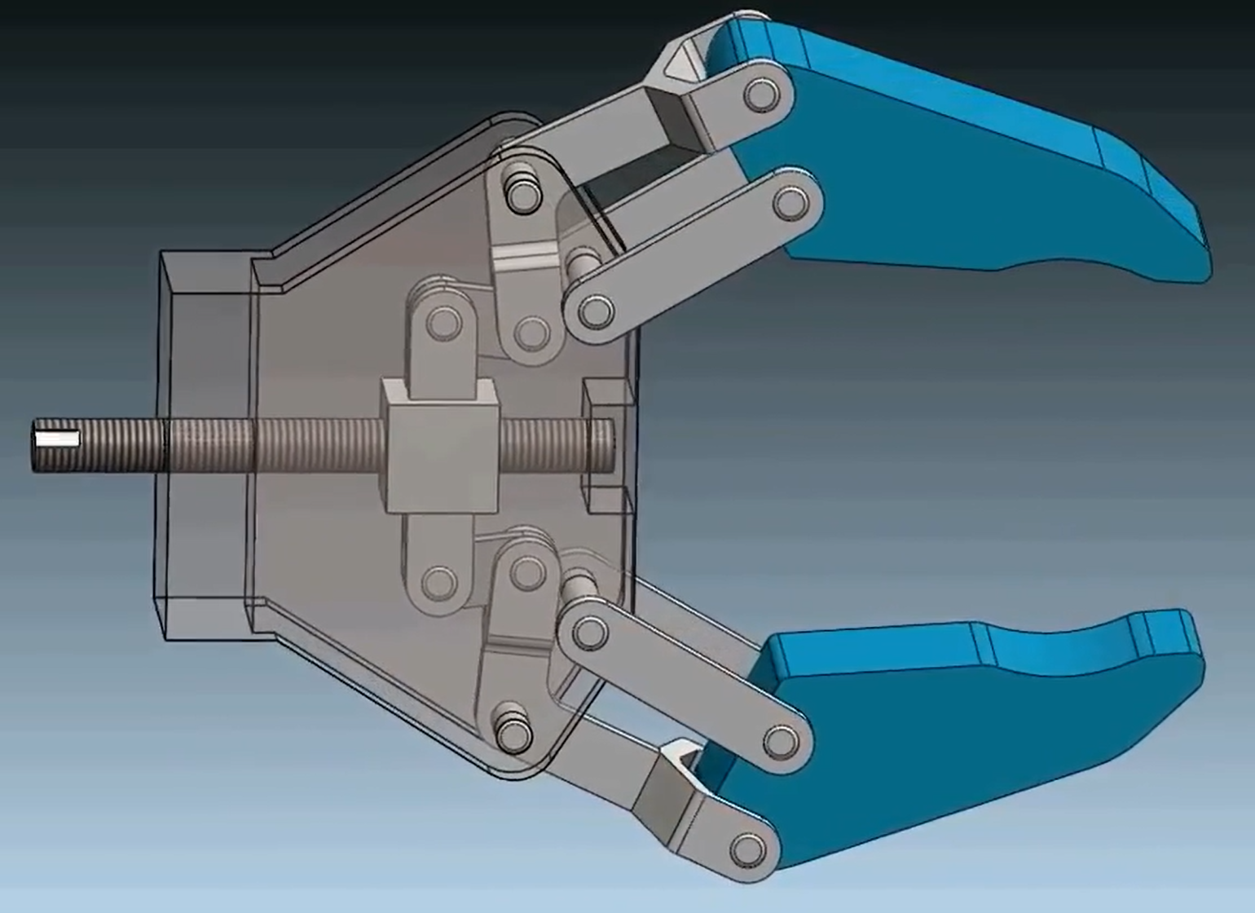
Design of Self-Locking Mechanism
Hint:
Without self-locking
J3
J1
J1
J3
J2
J2
Sliding block
With self-locking

Slide 10
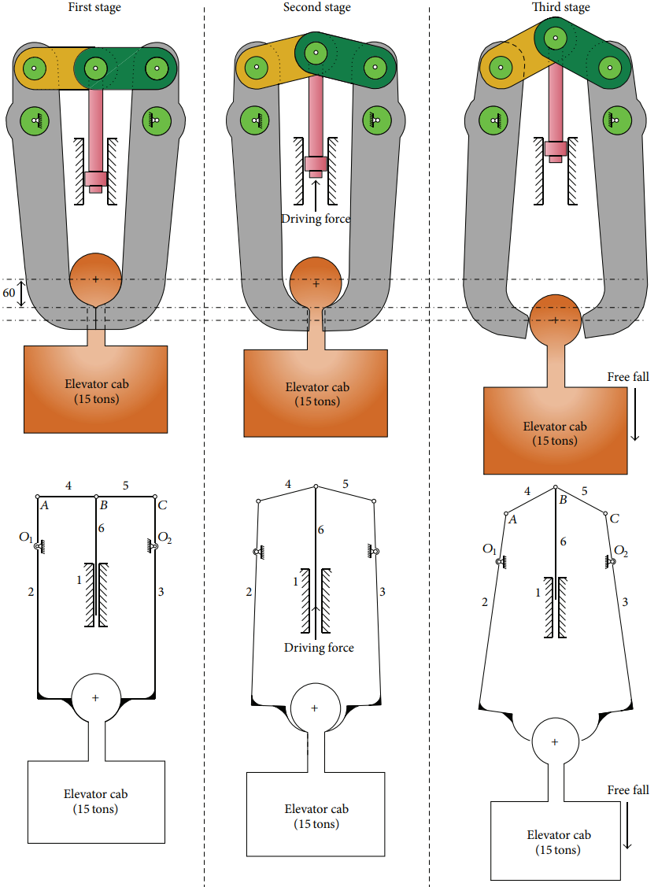
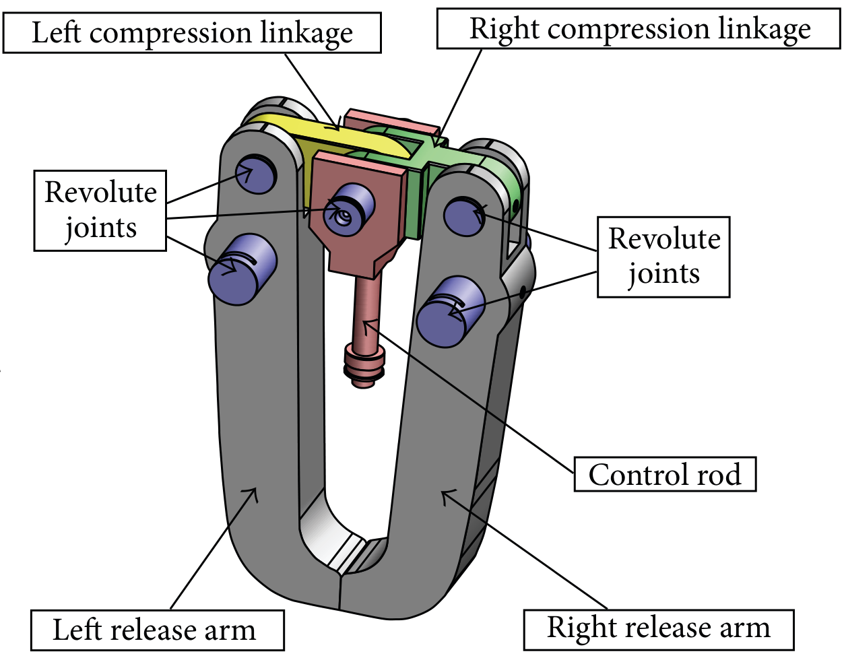
Design of Self-Locking Mechanism
Toggle Position Case study 2: Self-Locking Quick Release Mechanism
Bing, Xu & Dong, Pengpeng & Zhang, Junhui & Liu, Maoke & Yao, Jinjin. (2014). Design and Evaluation of a Novel Self-Locking Quick Release Mechanism Featured by Heavy Load, Fast Response, and High Security. Advances in Mechanical Engineering. 2014. 1-16. 10.1155/2014/590936.
Notes:
https://engineeringtechnology.org/equipment-and-machine-elements/linkages/over-center-linkages/

Slide 11
Aim for Gripper Design
Zero-Power Locking Mechanism
“Clamping mechanism must hold position passively”
Task:
Derive one self-lockable gripper that can hold the cylinder
* Open for various design schematics (ref. to textbook, journals, online resources, etc.)

Slide 12
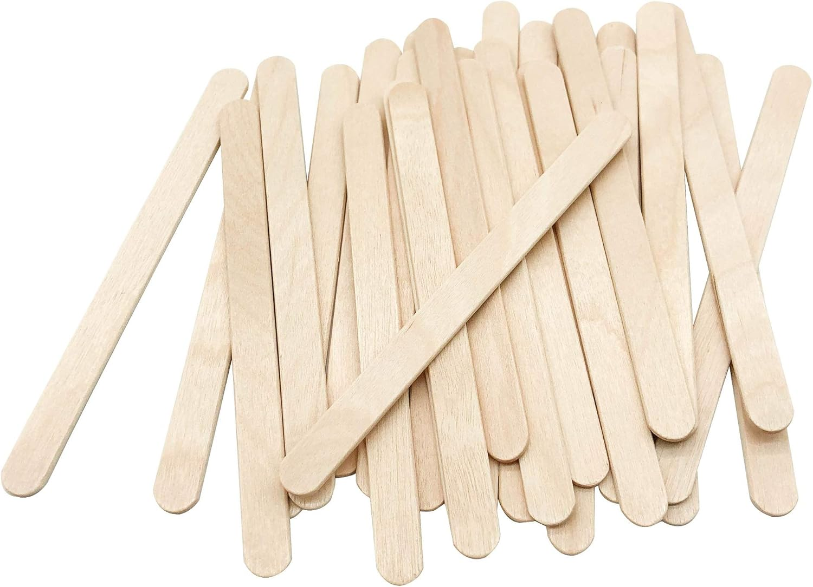
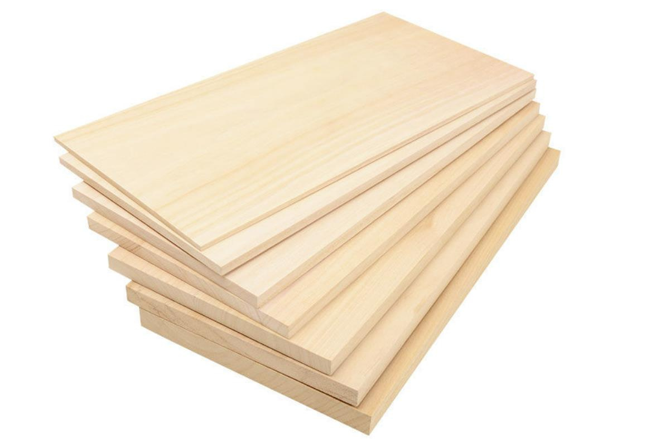
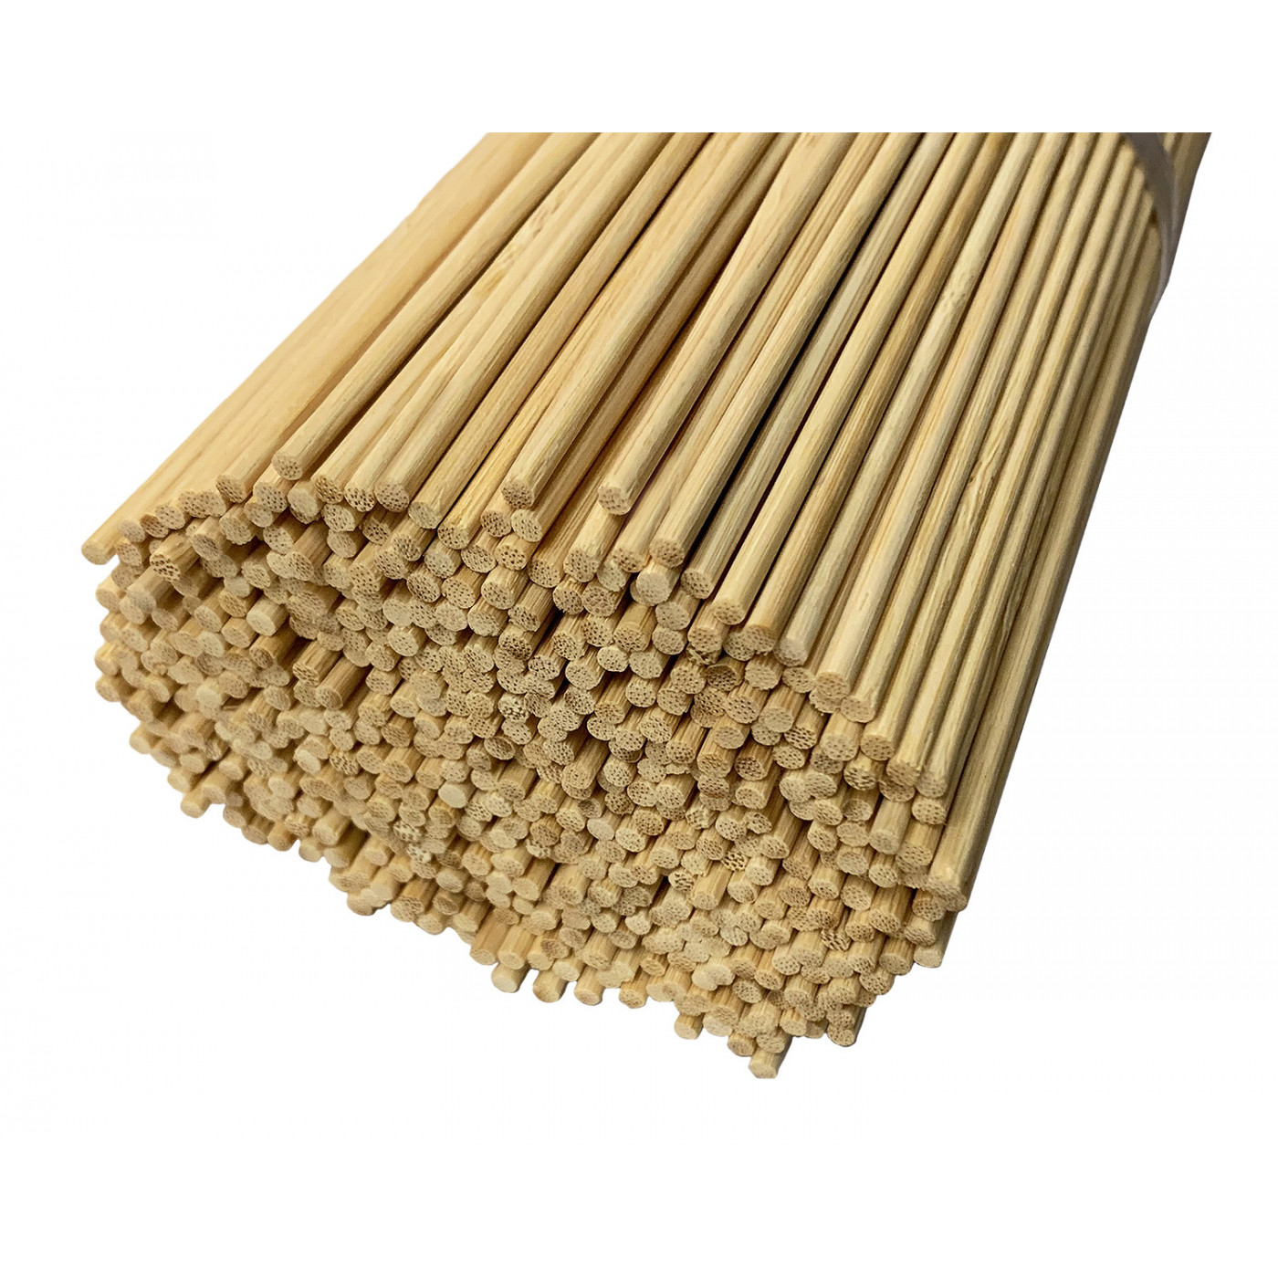
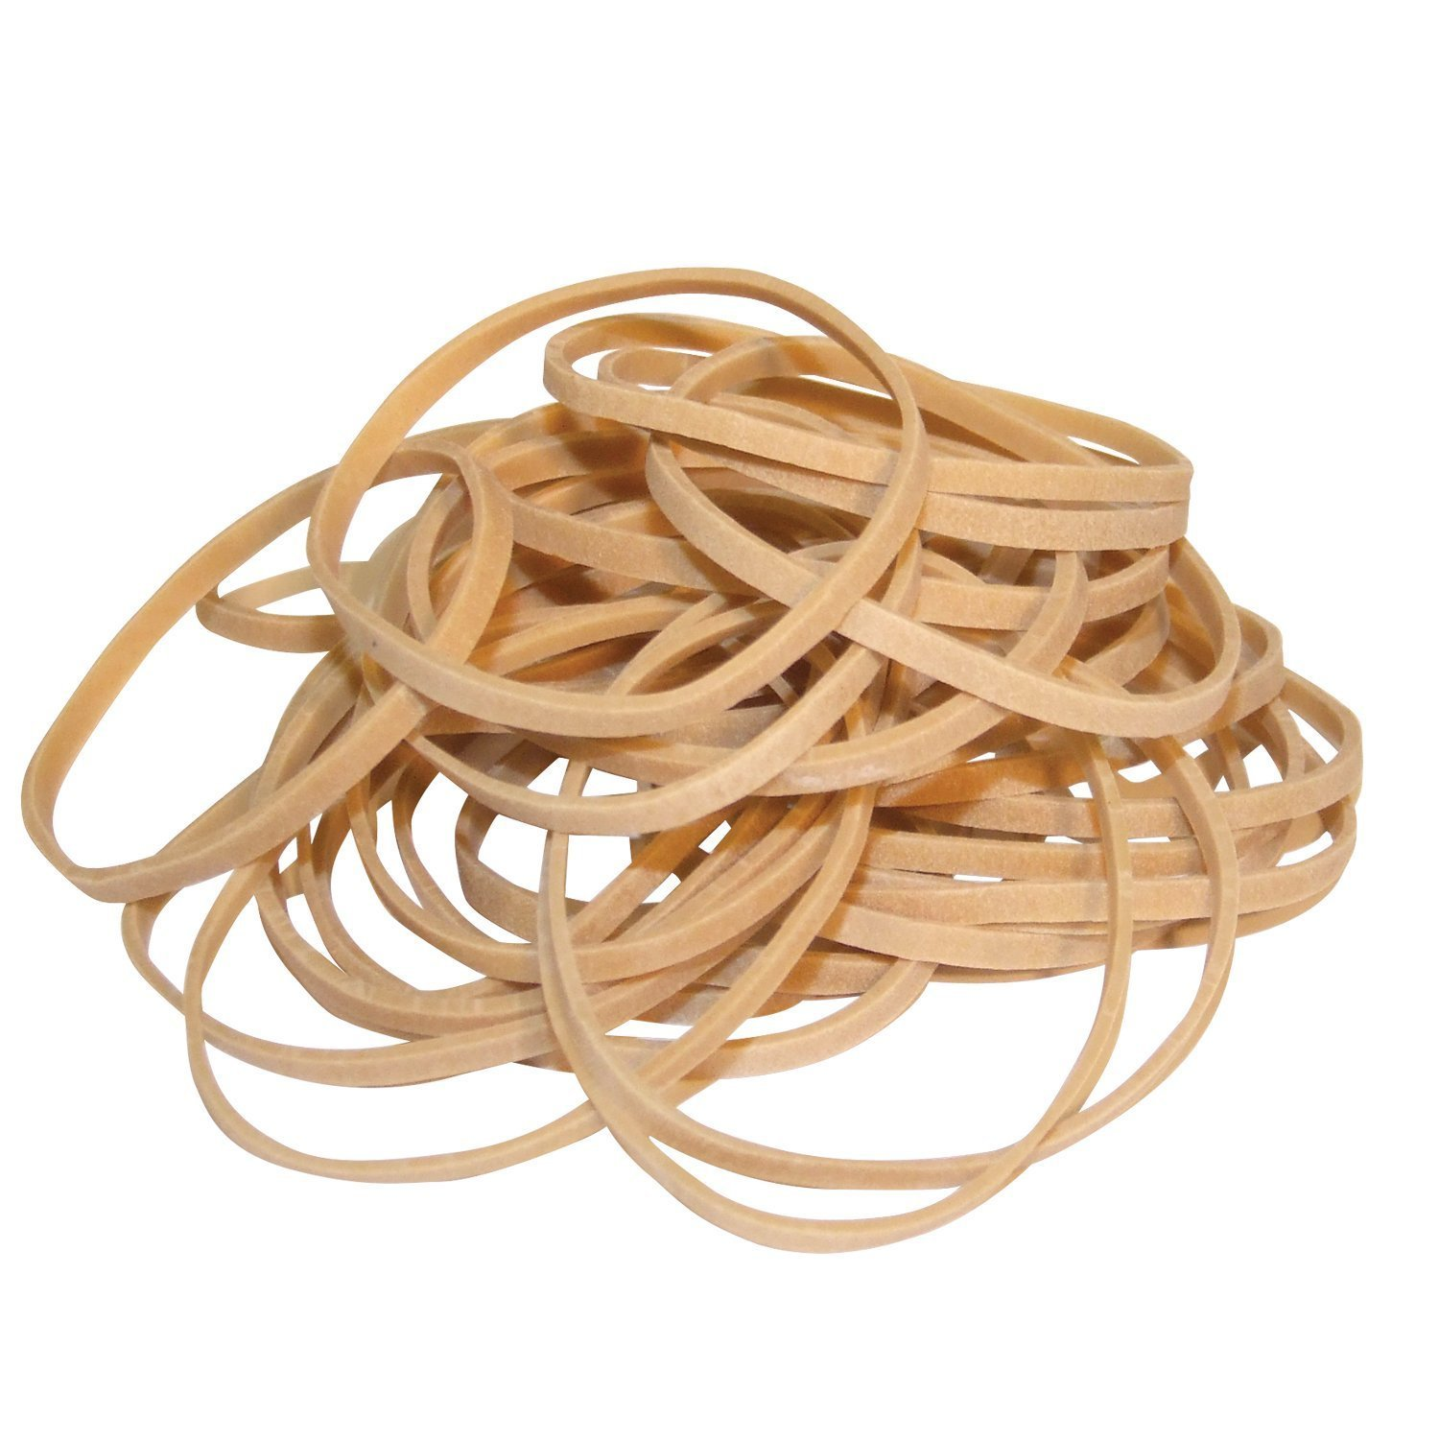
Material & Tools
Ice cream sticks
Length: 140mm, 160mm, 180mm (width 10mm+) 20 pieces each
Thin wooden boards
Thickness: 2-4mm
Length and width:
10cm*10cm, 5cm*5cm
10 pieces each
Rotating shafts:
Small wooden sticks/skewers
Rubber bands:
Several

Slide 13
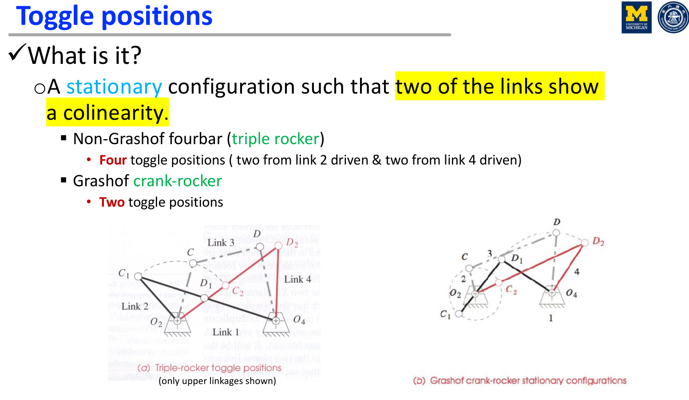

Slide 14
Project Assignment
Step 1: Design (synthesize) linkages to your clamp model considering the required self-locking target
Draw a sketch on your device (including linkages) with materials information. Justify the dimension of your device related to the function of the robot. (You may notneed to use a CAD drawing at this assignment. If you insist, you may use it.)
You may check the Toggle position(s) on your design of linkages.
How many linkages are used in your device?
Is the linkage you designed a Grashof or non-Grashof case?
Step 2: Discuss how to achieve locking & unlocking functions
Dimension
Actuation method
Step 3: Discussions
Discuss some issue on your synthesis
Team members’ contribution

